Slide 1
NBD1100 Built Environment Communication and Skills

Slide 2
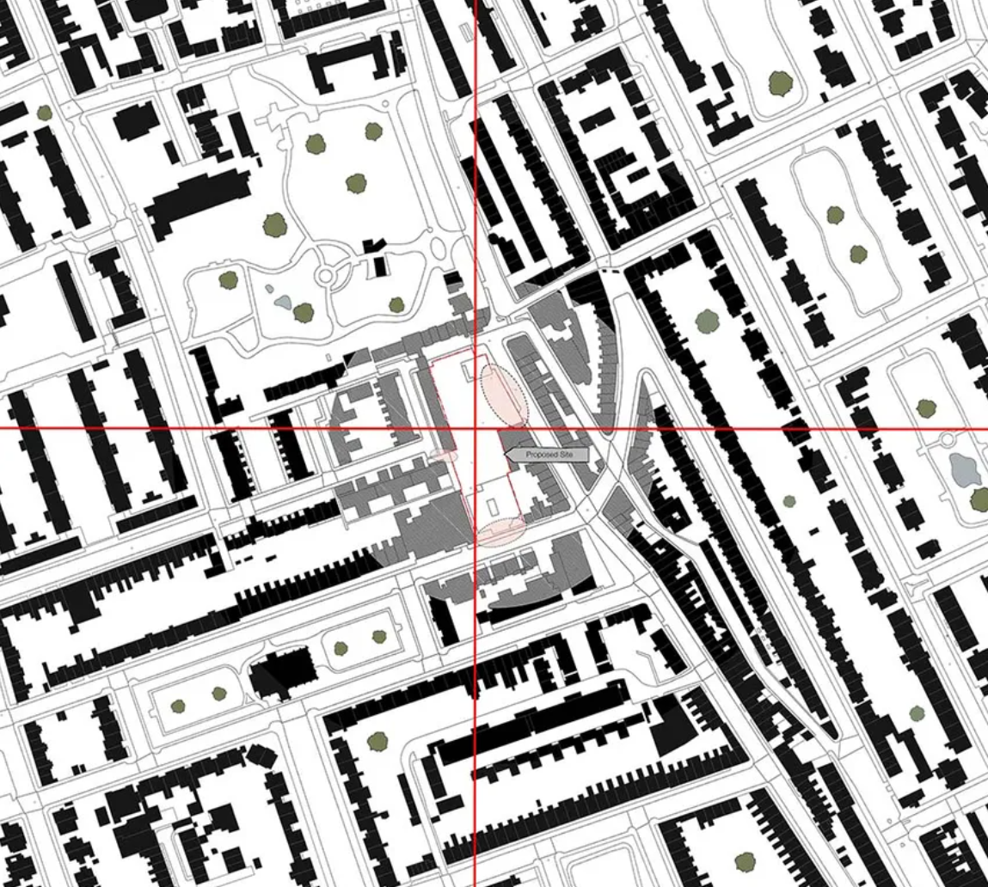
General
Geographic location
Site boundary
Entrance locations and types
Site security
Existing buildings

Slide 3
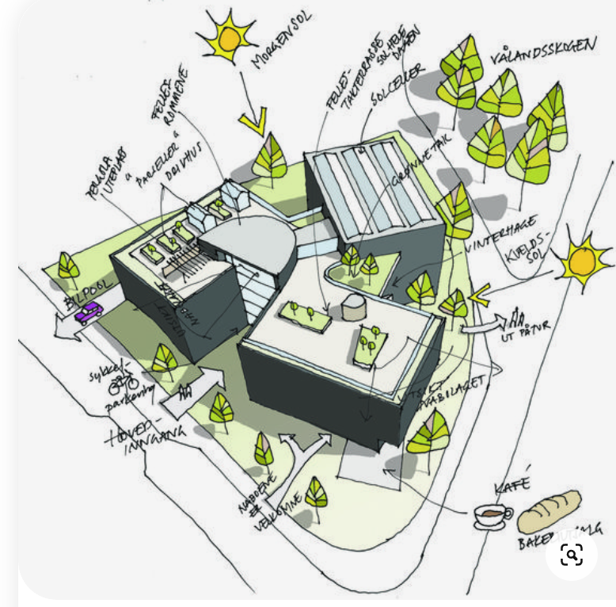
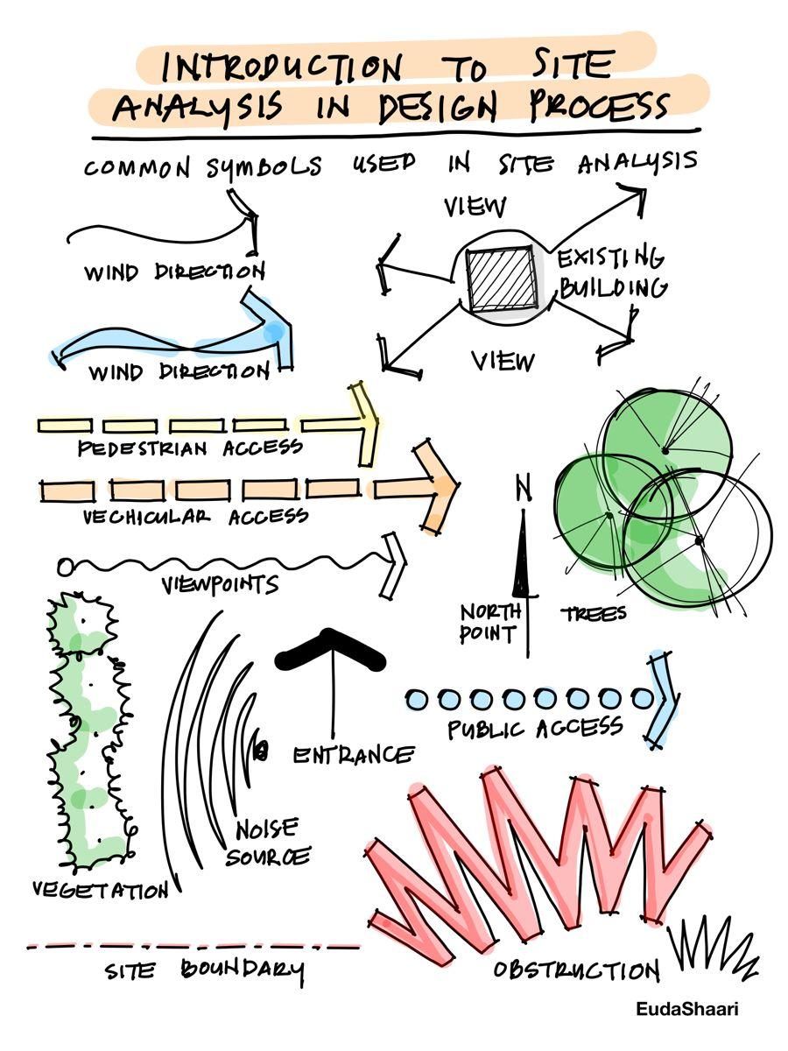
Neighbourhood context
Zoning and size
Legal information
Human and culture
Natural physical features
Man made features
Circulation
Utilities
Climate
Sensory

Slide 4
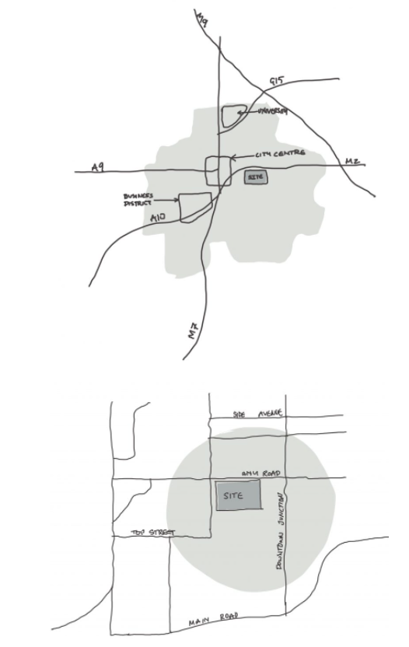
Location:
Geological maps
Aerial photographs and maps
Historical maps
Distances and travel times

Slide 5
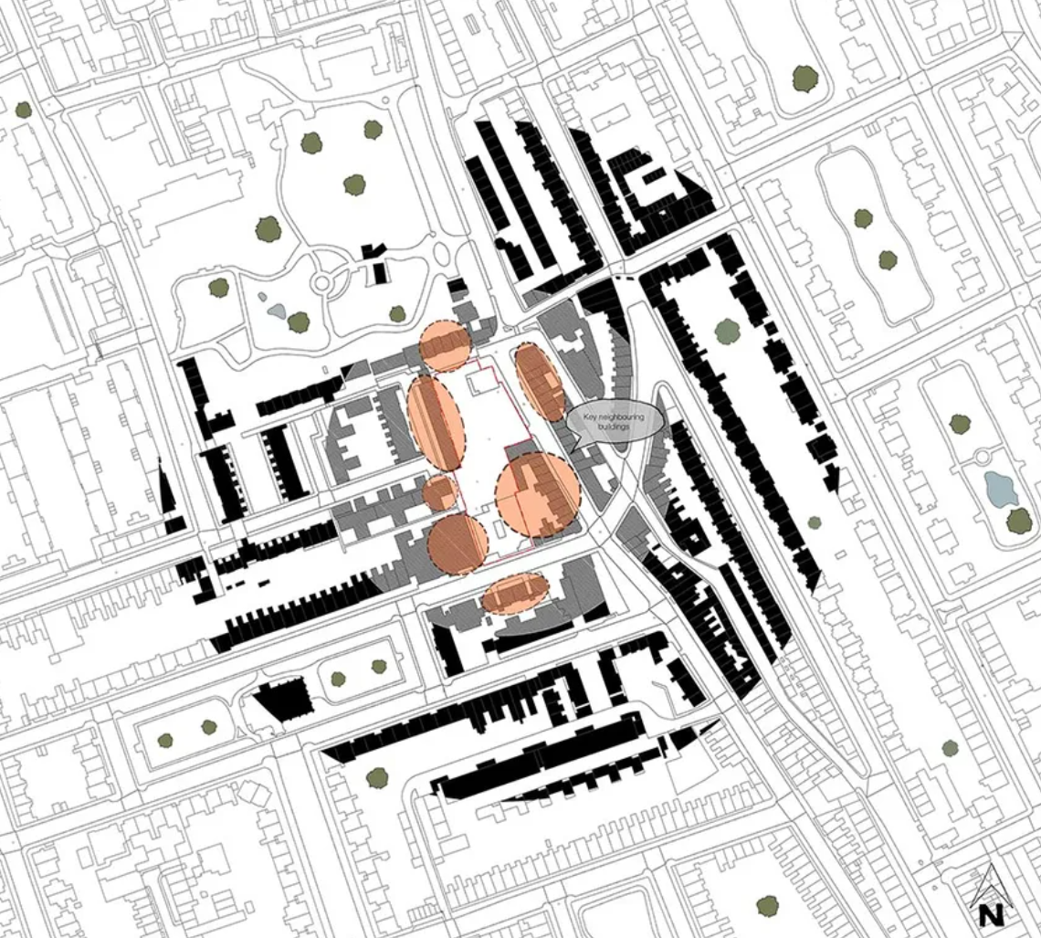
Neighbouring buildings
Distances
Heights
Uses
Vernacular
Site lines
Rights to light
Legal restrictions
Noise levels

Slide 6
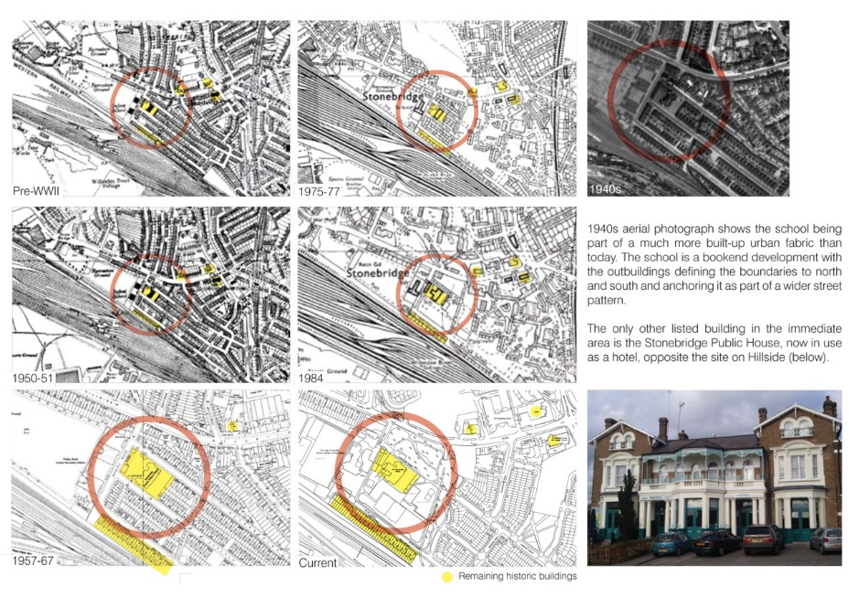
Legal and Historical Information:
Accessibility & rights of way
Planning restrictions
History of the site
Historical use of the site
Conservation area
Cultural significance, historic significance
Developmental controls
Tree Preservation

Slide 7
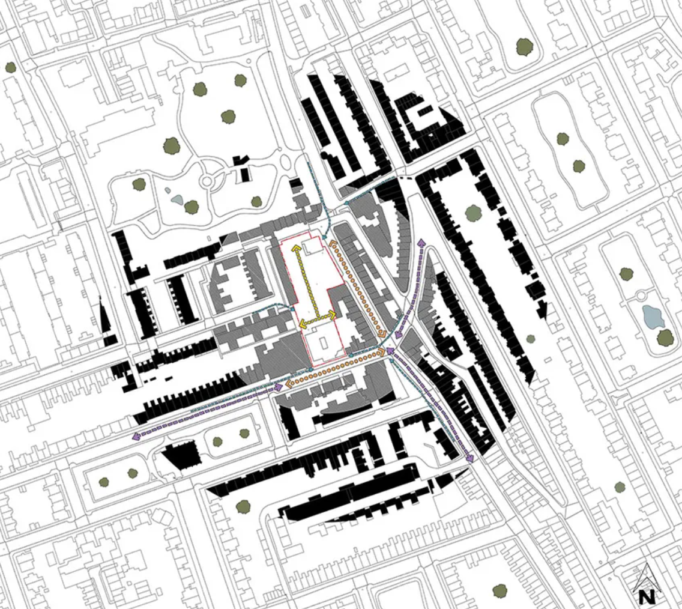
Access
Public routes
Private routes
Vehicle access
Pedestrian access
Existing circulation routes within

Slide 8
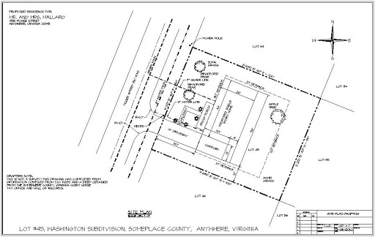
Utilities:
Water
Electricity
Gas
Telephone
sewerage
other services

Slide 9
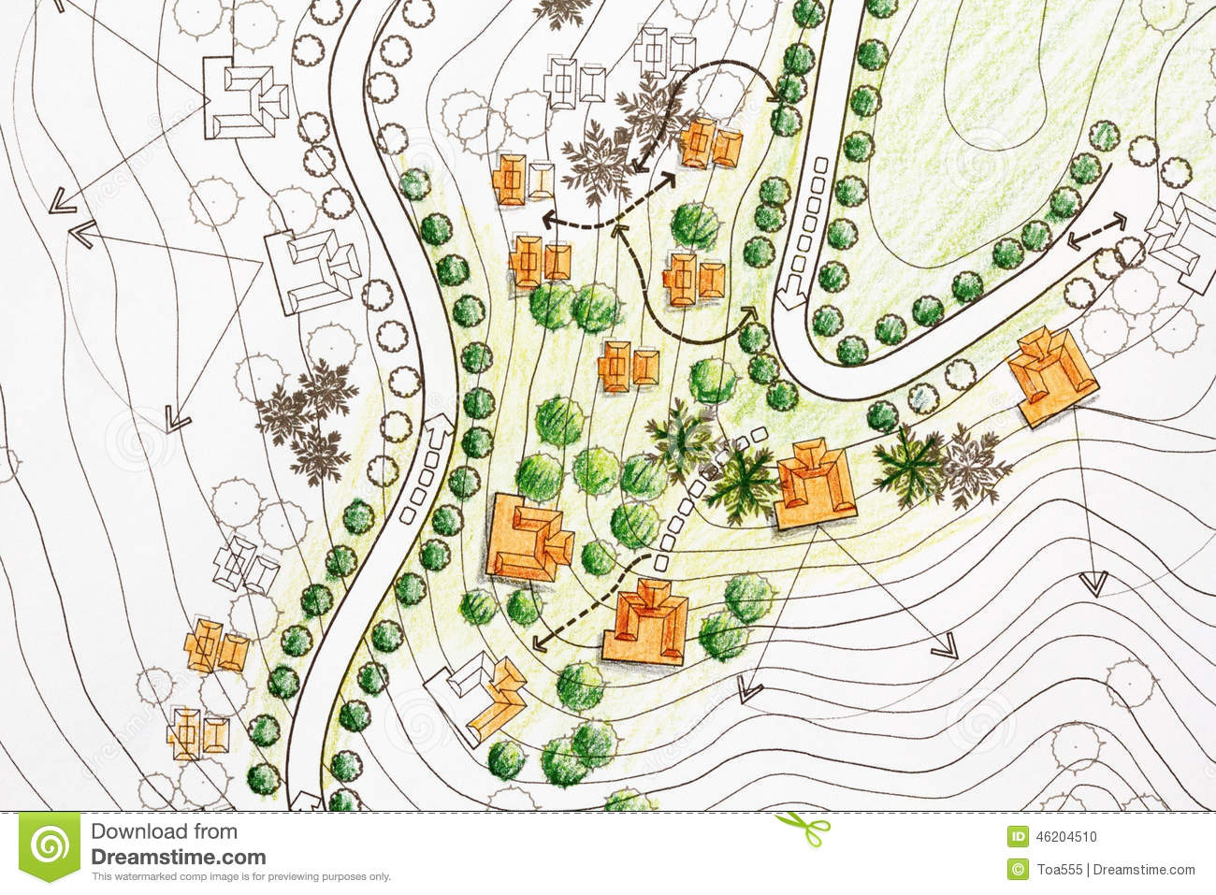
Topography
Levels
Gradients
Key features/restrictions
Exposure

Slide 10
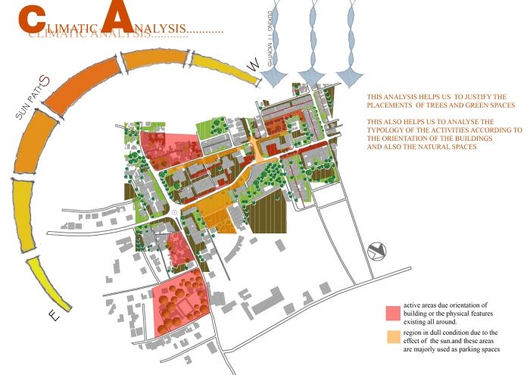
Climate:
Climate conditions
Sun path and angles
Wind patterns
Flooding

Slide 11
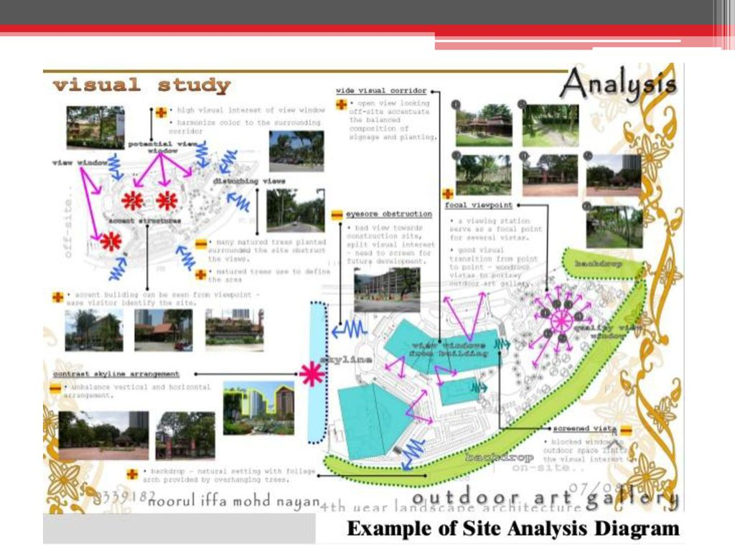
Sensory
Views
Private views out
Public views in
Noise and odour

Slide 12
Sensory
Views
Private views out
Public views in
Site restrictions
Visibility
Light
Views
Neighbors
Pollution
Land slides

Slide 13
Sensory
Views
Private views out
Public views in
Site restrictions
Visibility
Light
Views
Neighbors
Pollution
Land slides

Slide 14
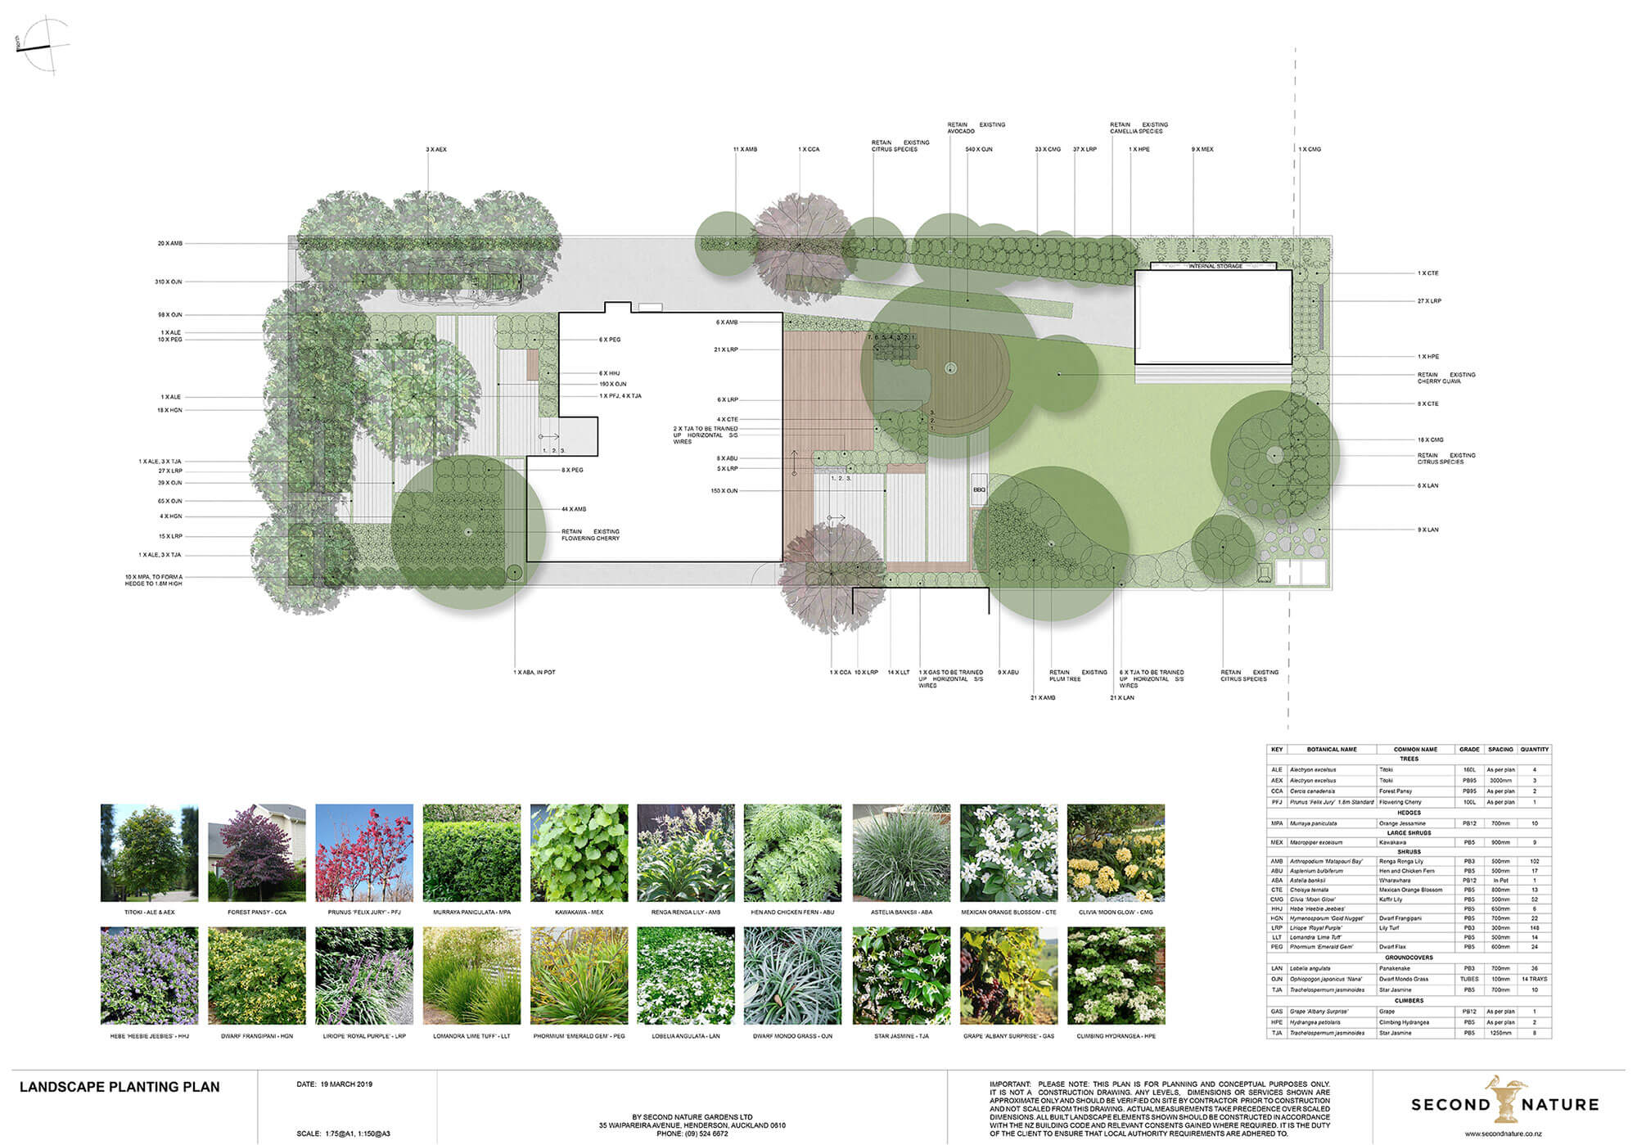
Trees and vegetation
Ecology

Slide 15
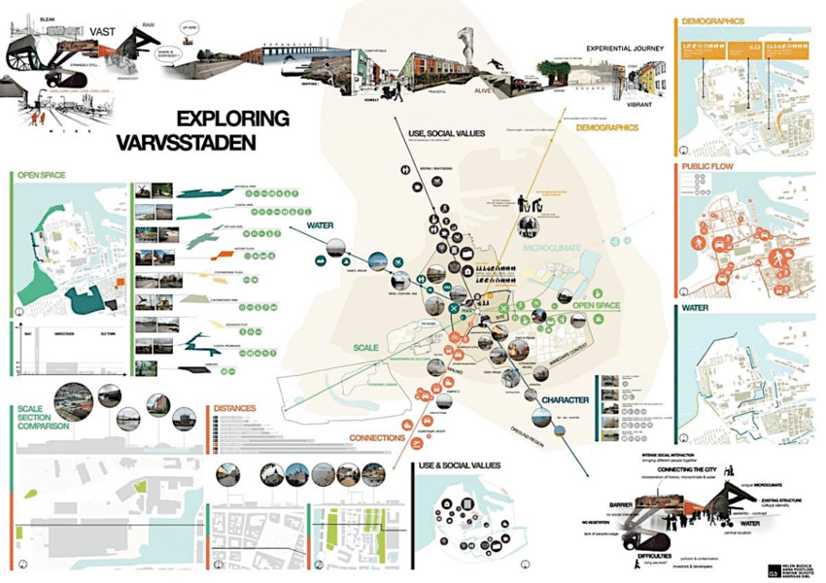
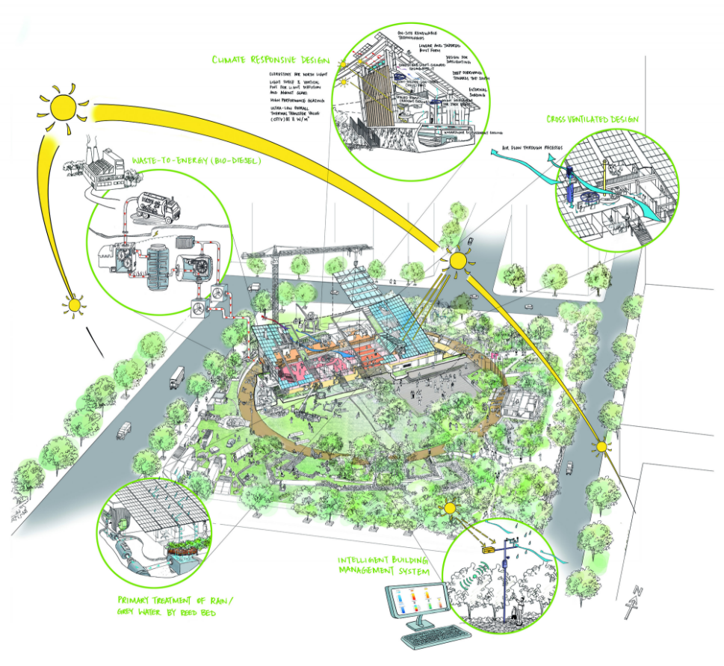
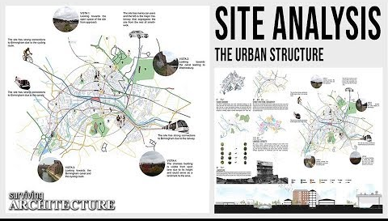
Site Visit and Site Analysis

Slide 16
The Site
Street patterns
Street section
Scale and the hierarchy/form/space
Land use
Typologies
Neighbourhood relationships, formal street variation
Perspective relationships, views
Edge conditions, surfaces and materials
Natural and man made
Movement and circulation within and around the site
Vehicle vs. pedestrian
Access
Public space vs. private space
Open space
History
Climate – sun angles and sun shadows
Negative and positive spaces – we move through negative spaces and dwell in positive spaces

Slide 17
The Site
Street patterns
Street section
Scale and the hierarchy/form/space
Land use
Typologies
Neighbourhood relationships, formal street variation
Perspective relationships, views
Edge conditions, surfaces and materials
Natural and man made
Movement and circulation within and around the site
Vehicle vs. pedestrian
Access
Public space vs. private space
Open space
History
Climate – sun angles and sun shadows
Negative and positive spaces – we move through negative spaces and dwell in positive spaces

Slide 18
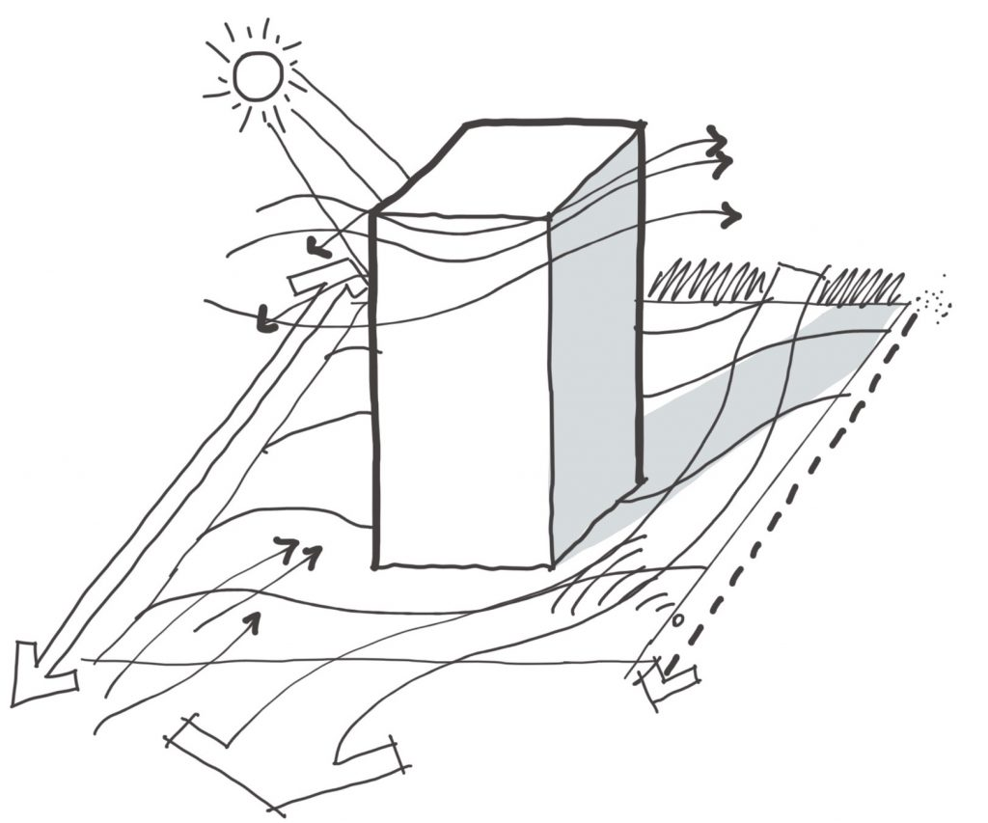
The Building
Think about how your proposal is going to link in with the site, and how the site will connect with the building. Make a few notes about each of the points below about what you are looking to achieve.
Massing
Structure
Circulation
Axis
Symmetry
Scale and proportion
Balance
Regulating lines
Light quality
Rhythm and repetition
Views
Geometry
Hierarchy
Enclosure
Space/void relationship

